Slide 1
Debugging in IntelliJ

Slide 2
What is Debugging?
What is debugging?
Debugging is the process of detecting and correcting errors in a program.
First, eliminate the compile errors. These are the red squigglies.
That leave the logic errors. They show up when you run the program. It might crash or get the wrong answer.

Slide 3
How to Debug
How to debug?
During a debugging session, you launch your program with the debugger attached to it.
The purpose of the debugger is to interfere with the program execution and provide you with the information on what’s happening under the hood.
This facilitates the process of detecting and fixing bugs in your program.

Slide 4
Before you Debug
Before you Debug
Make sure the Generate debugging info option is turned on (the default setting) in Settings>Preferences > Build, Execution, Deployment > Compiler > Java Compiler.
This setting is not absolutely required for debugging, however we recommend leaving it enabled. Disabling it allows you to save disk space at the cost of some debugger functionality.

Slide 5
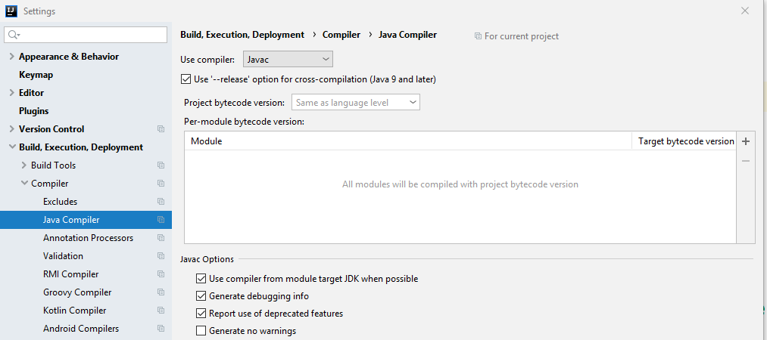

Slide 6
Steps to Debugging
Examine the Code
Set breakpoints to suspend the program in places you want to examine its state.
Run your program in debug mode.
When suspended, get the information about the state of the program and how it changes.

Slide 7
Examine the code:
public class AverageFinder {
public static void main(String[] args) {
System.out.println("Average finder v0.1");
double avg = findAverage(args);
System.out.println("The average is " + avg);
}
private static double findAverage(String[] input) {
double result = 0;
for (String s : input) {
result += Integer.parseInt(s);
}
return result;
}
}
The program is supposed to calculate the average of all values passed as command-line arguments.
It compiles and runs without issues, however, when we pass 1 2 3 as the input, the result is 6.0.
First, think about where the suspected error might be coming from.
Most likely, unexpected results are coming from our findAverage method.
In order to find the cause, let's examine its behavior at runtime.

Slide 8
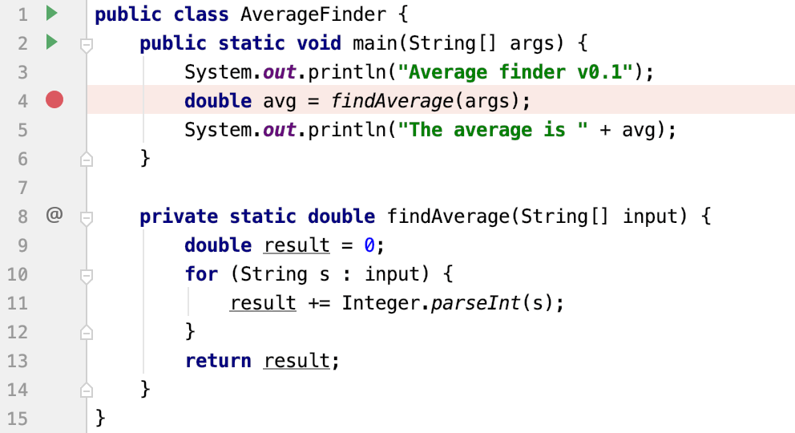
To Set Breakpoints, click the gutter at the line where the findAverage method is called.

Slide 9
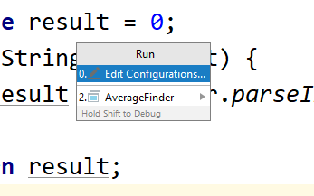
Run the Program in Debug Mode
From the main menu, select Run > Edit Configurations.

Slide 10
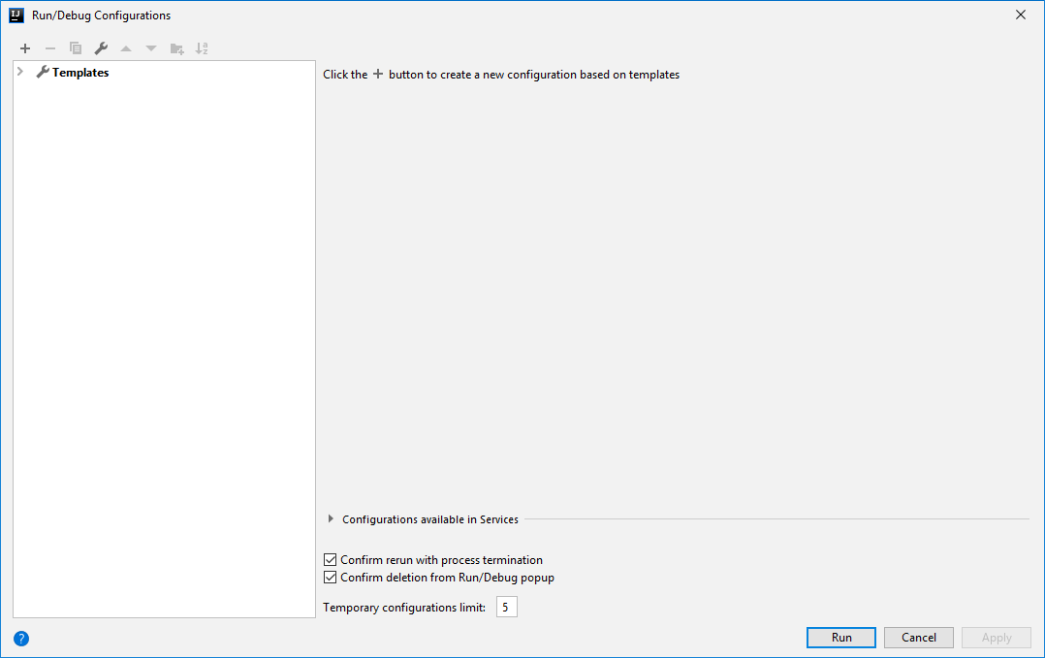
You will get this window, click the + button

Slide 11
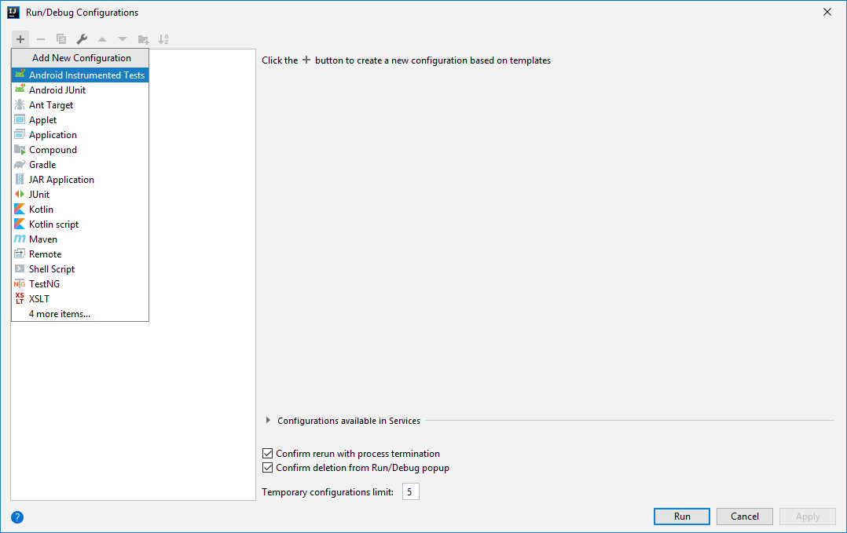
You will get this list of choices, select Application

Slide 12
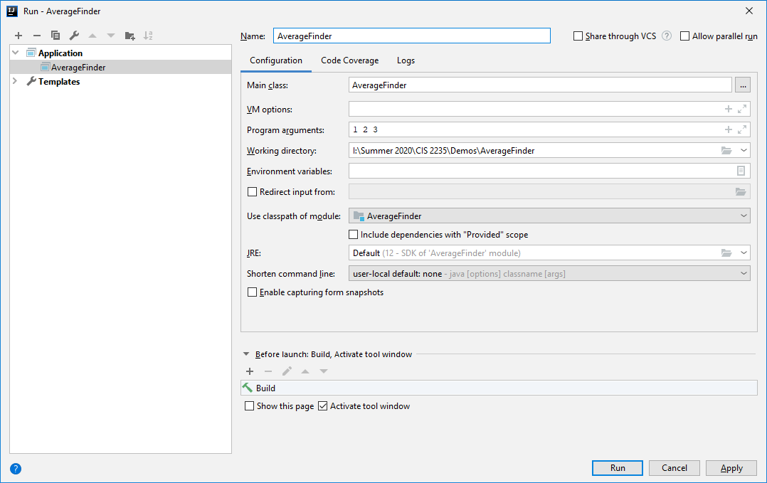


Add the name of the application to the top, and the Main class, the arguments, then press Run. It will show the errors.

Slide 13
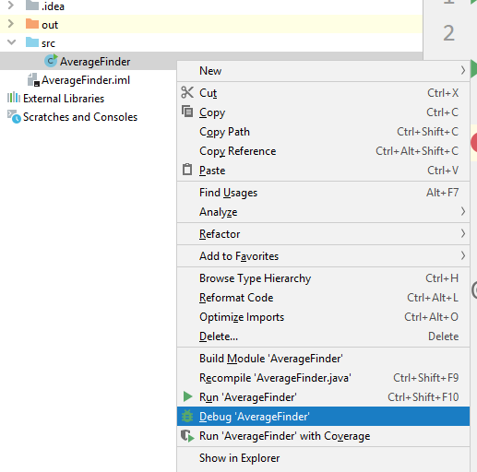
Now run on Debug:
Right-click on the class
containing main and select:
Or, you can
click the bug in the top
toolbar
Or, select Run >
DebugAverageFinder

Slide 14
Analyze the Program state
Analyze the Program state
After the debugger session has started, the program runs normally until a breakpoint is hit. When this happens, the line where the program paused gets highlighted and the Debug tool window appears.
The highlighted line has not been executed yet. The program now waits for further instructions from you. The suspended state lets you examine variables, which hold the state of the program.
See next slide

Slide 15
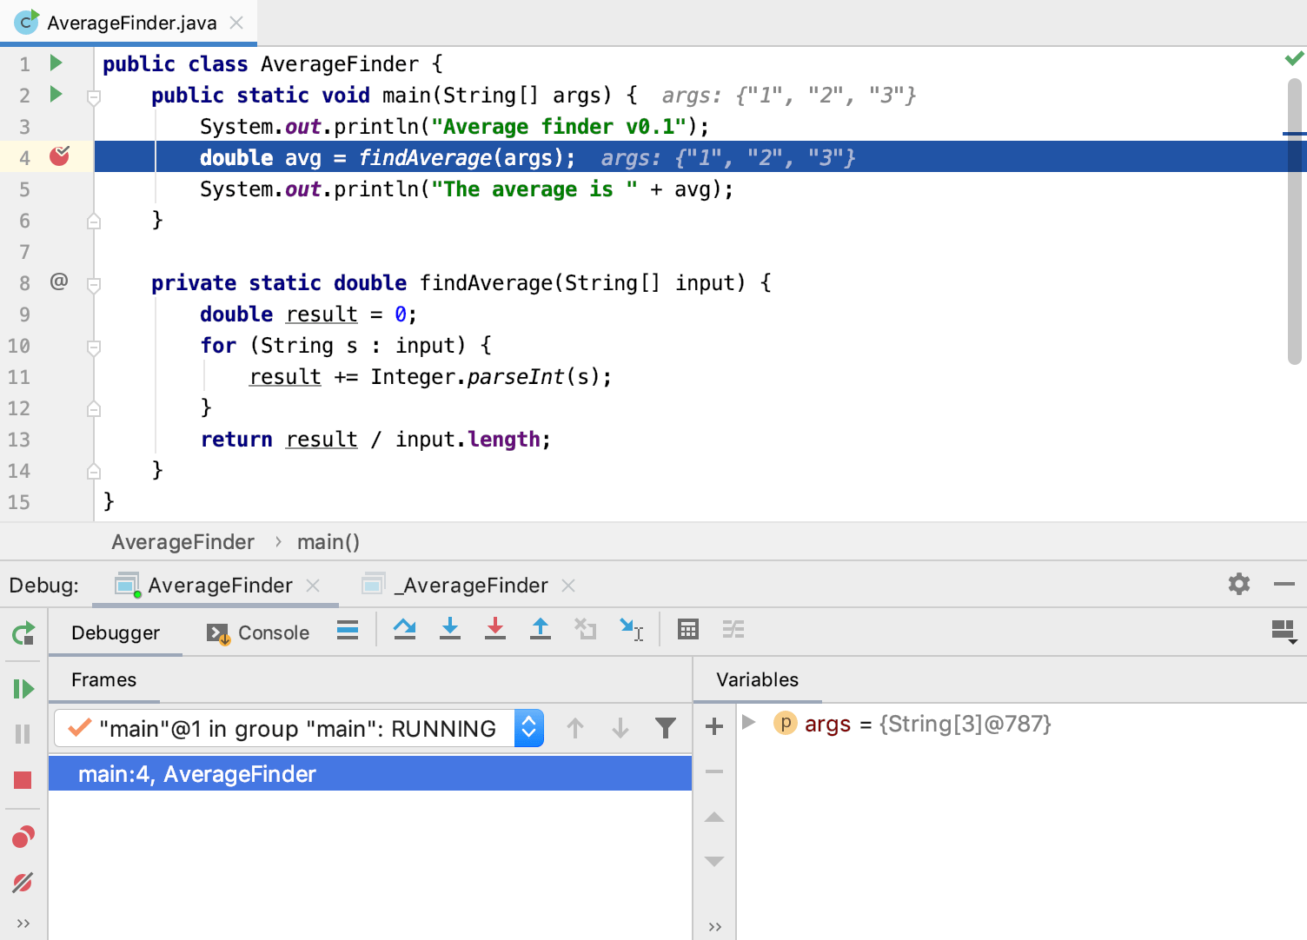
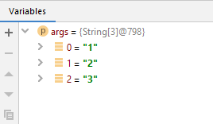
Notice the args array values, which are in scope
You can also see arg values in the Variables panel

Slide 16
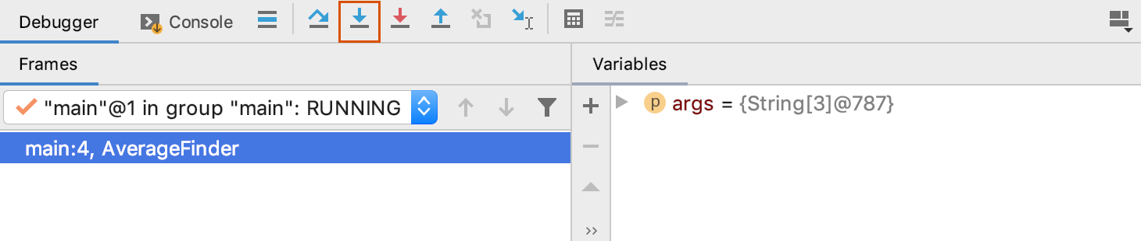
Step Through the Program
To step into the findAverage method, click the Step into button or press F7

Slide 17
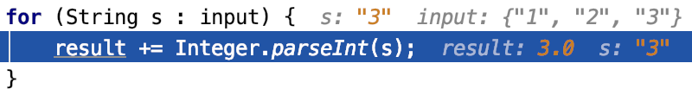
Keep stepping and see how a local variable result is declared and how it is changed with each iteration of the loop.
Right now the variable s contains the value "3".
It is going to be converted to an Integer and be added to result, which currently has the value of 3.0.
No errors so far. The sum is calculated correctly.

Slide 18
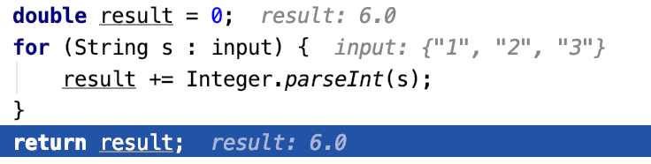
Two more steps take us to the return statement, and we forgot to divide by the number of values
Correct the error by changing the statement to:
return result./input.length

Slide 19
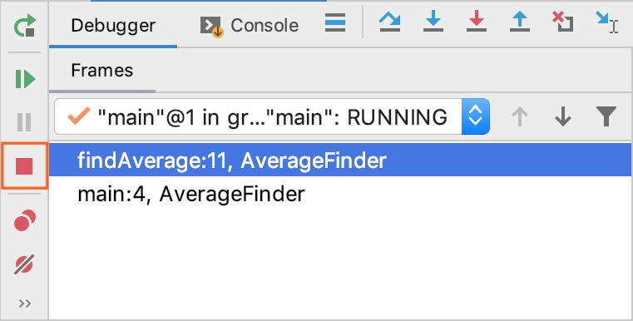
Stop and rerun the program
Click the red square STOP button or press Ctrl + F2
There is another red square button at the top toolbar on the right

Slide 20
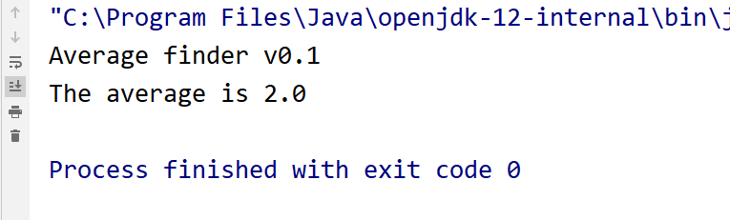
Verify that the error was corrected

